Slide 1
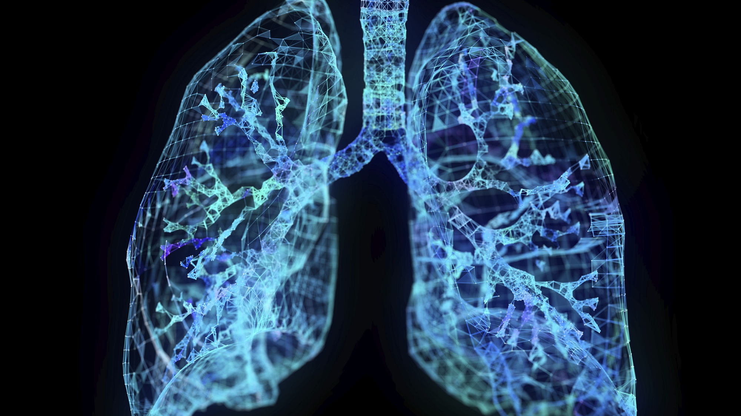

MOARADABAD INSTITUTE OF TECHNOLOGY PRESENTED BY project guide AMOL JAIN (B.Tech 4th year) Sanjeev gupta BHASKAR SAINI (b.tech 4th year) HAMMAD HUSSAIN (b.tech 4th year) CHANDRVEER SINGH (b.tech 4th year)

Slide 2
CONTENTS
Cancer
Types of lung cancer
Lung cancer
Stages In Lung Cancer
Medical Imaging Techniques
Methodology
Literature Review
Conclusion
Future Scope
Drawback
Demo of the project
Refrences

Slide 3
cancer
Cancer is a disease in which some of the body’s cells grow uncontrollably and spread to other parts of the body.
Cancer can start almost anywhere in the human body, which is made up of trillions of cells.
Normally, human cells grow and multiply (through a process called cell division) to form new cells as the body needs them. When cells grow old or become damaged, they die, and new cells take their place.

Slide 4
TYPES OF CANCER
MOST COMMONLY DIAGNOSED CANCER
LUNG
BREASTS
PANCREAS
GLANDS

Slide 5
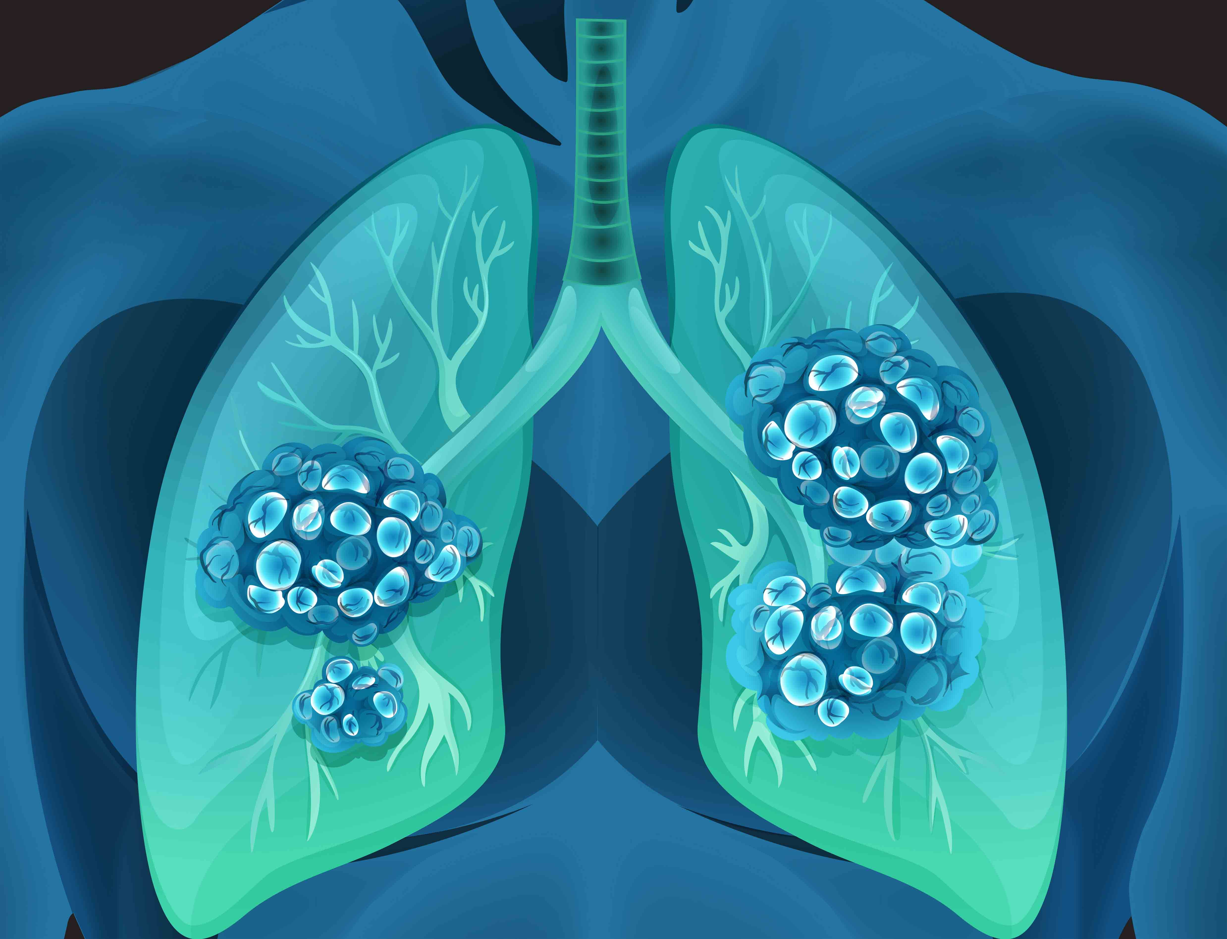
Lung cancer
Lung cancer is a disease in which cancer cells originate from the lung itself or from another organ.
Lung Cancer is also called a lung tumor and is characterized by highly uncontrolled cell growth.
Lung cancer is the leading cause of death worldwide.
It is essential to identify the presence of cancer in early stages to improve the treatment and treatment process.

Slide 6
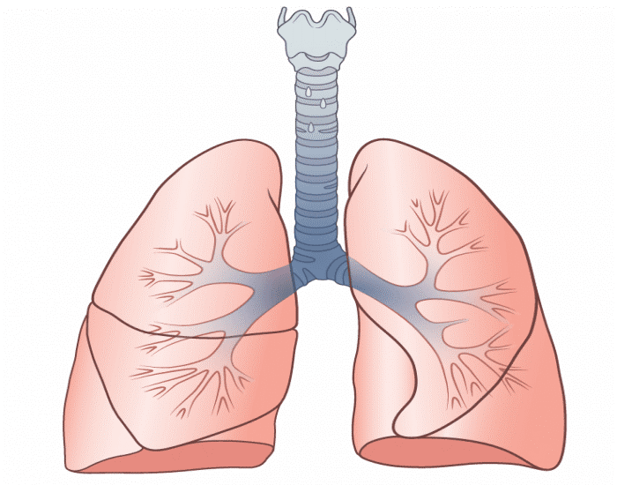
LUNG ANATOMY
Lungs are a part of the human respiratory system and the role of the lungs is to oxygenate the blood and remove carbon dioxide and other gases that are waste for the human body.
Lungs are a pair of spongy, roughly cone-shaped structures present on either side of the chest. Air is inhaled through the mouth or nose.
The lungs are separated by the mediastinum. This area contains the heart, trachea, esophagus, and many lymph nodes. The lungs are covered by a protective membrane known as the pleura and are separated from the abdominal cavity by the muscular diaphragm.

Slide 7
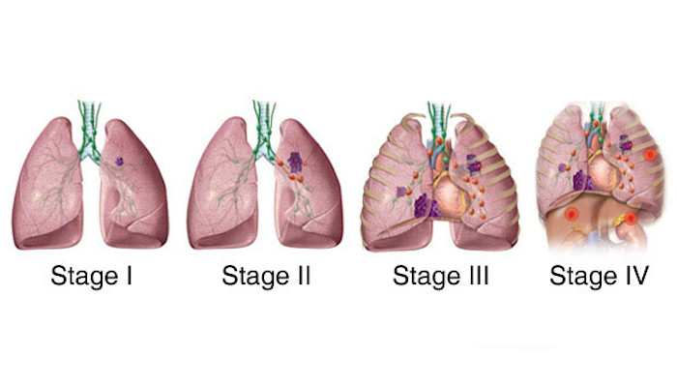
STAGES IN LUNG CANCER
Small cell
Limited Stage: Cancer is only in one lung and the second lung is healthy.
Extensive Stage: Cancer has spread to the chest and both lungs.
Non small cell
Occult stage: It is also called hidden cancer. In this stage, the mucus contains cancer cells. Cancer in this stage can't be detected by using a biopsy or any imaging technique.
Stage 0: In this stage, the tumor formed is very small and the lungs are still non-infected.
Stage I: In this stage, lung tissue shows the presence of cancer.
Stage II: In this stage, lymph nodes close to the lungs might be infected with cancer.
Stage III: In this stage, the chest and the lymph node might be infected with cancerous cells.
Stage IV: In this stage, bones, liver, brain, or any other body part might be infected with cancer

Slide 8
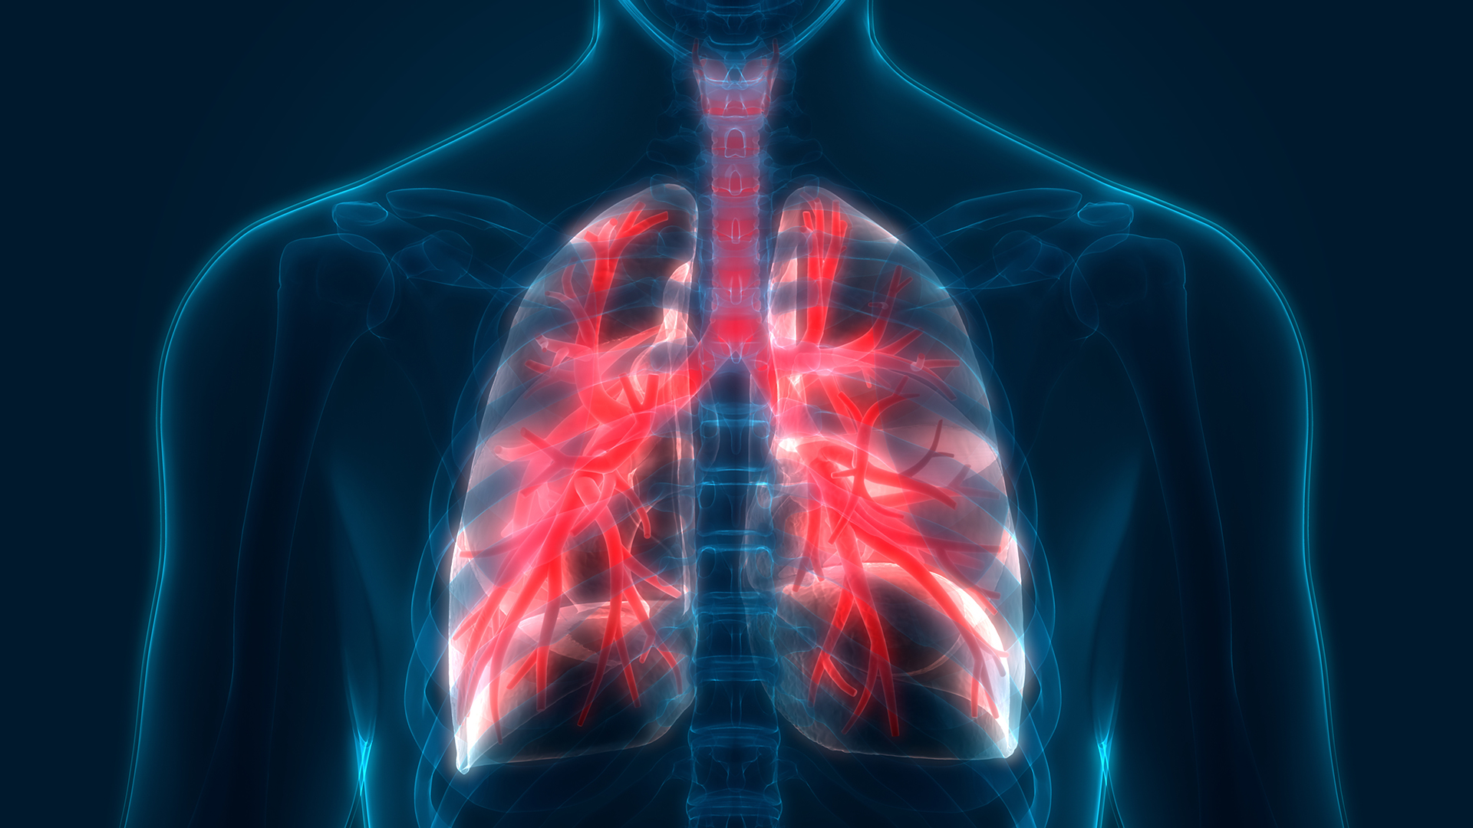
Medical Imaging Techniques
X-RAY : X-ray is painless and quick imaging technique that produces the image of structure inside your body. The Imagine method that is used in X-Ray is called Ionizing Radiations.
Computed tomography scan (CT scan) : CT scan machine is a large doughnut-shaped machine and the patient is made to lie down flat on a bed that passes through the machine.
Magnetic resonance imaging (MRI) : In MRI patient is made lie on a bed that goes into the MRI machine. The magnets inside MRI machine create loud striking noises.
Ultrasound : The Ultrasound makes use of the sound waves to produce image of the inside of body. The sound waves that are used in ultrasound are of high frequency i.e. 20 kHz and higher to produce the image of organs and structures inside the body.
Positron emission tomography scan (PET scan): In PET scans radioactive drugs called FDG and a scanning machine is used to show the functioning of patient tissue and organs. In a PET scan, the patient is made to swallow or inject a radiotracer. Then the patient is made to lie on a bed that goes through the scanner.

Slide 9
METHODOLOGY ADOPTED
The methodology focuses to obtain a more accurate result. Firstly, the CT scan input image through the pre-processing method. It is done by first converting the input image to a grayscale image. After converting the image, we used various filters such Sobel filter , gabor filter and gaussian filter.
In General methodology they are following four principle steps :
Image Preprocessing
Image Segmentation
Feature Extraction
Classification

Slide 10
literature review
paper | Title | Technique Applied | Findings
[1] | Lung cancer detection and classification using CT scan image processing | The support vector machine (SVM) algorithm is applied. | The dataset is taken from TCIA which contains CT scan images . (SVM) algorithm is applied as the classifier to classify the detected tumor into malignant or benign.
[2] | Lung cancer detection and classification based on alexnet CNN | The classification is performed using the Alex Net CNN model. | The classification is performed using the AlexNet CNN model. This paper claims an accuracy of 96%.
[3] | Lung Cancer Detection Based On CT-Scan Images With Detection Features Using Gray Level Co-Occurrence Matrix (GLCM) and Support Vector Machine (SVM) Methods | Support vector Machine | Images were converted into grey scaled SVM is used as a classifier. This model achieved an accuracy of 83.33%.

Slide 11
paper | Title | Technique Used | Findings
[4] | Classification of Lung Cancer Stages from CT Scan Images Using Image Processing and k-Nearest Neighbours | k-nearest neighbors(kNN) algorithm was used to classify the input pattern. | Images were obtained from each patient and each image collected was of size 512x512 pixels. This paper achieved an accuracy of 98.15% with the help of using KNN Algorithm
[5] | classificationof pulmonary nodules using deep learning and swarm intelligence | Gravitational Search Algorithm. | The model is developed using a U-Net convolutional neural network. the maximum specificity of 98.52% with Gravitational Search Algorithm.
[6] | The Lung Cancer Predictive Accuracy for Non-Smokers Using Classification and HFPS Algorithm | HFPS Feature Selection algorithm along | The maximum accuracy achieved was 97.43% by using the HFPS Feature Selection algorithm along with the Recurrent Neural Networks classifier

Slide 12
paper | Title | Technique Used | Findings
[7] | A Holistic Performance Comparison for Lung Cancer Classification Using Swarm Intelligence Techniques | Naive Bayesian Classifier, Support Vector Machine, Decision trees, and k-nearest neighbors algorithms. | The paper claims the accuracy of . 99.10%.
[8] | Lung Cancer Detection Using Ct Scan Images | A region-based segmentation technique | Gabor filter is used for image enhancement. After this binarization is performed and an active contour algorithm is applied to the binarized image later watershed transform is performed.
[9] | Feature selection using competitive coevolution of bio-inspired algorithms for the diagnosis of pulmonary emphysema. | The Shape Fuzzy C-Means clustering algorithm. | The model proposed in this paper achieved an accuracy of 93.74%.

Slide 13
paper | Title | Technique Used | Findings
[10] | Lung Cancer Detection Using Marker Controlled Watershed with SVM | Marker-controlled watershed | They used the Gabor filter for image enhancement. After Image enhancement, they have used marker-controlled watershed.
[11] | Lung cancer detection using CT scan image | Marker-controlled watershed | This classifies the nodule as malignant or benign. This model achieved an accuracy of 92%.
[12] | Microarray cancer gene feature selection using spider monkey optimization algorithm and cancer classification using SVM | Sequential minimal optimization (SMO) | The proposed method achieved an accuracy of 91%

Slide 14
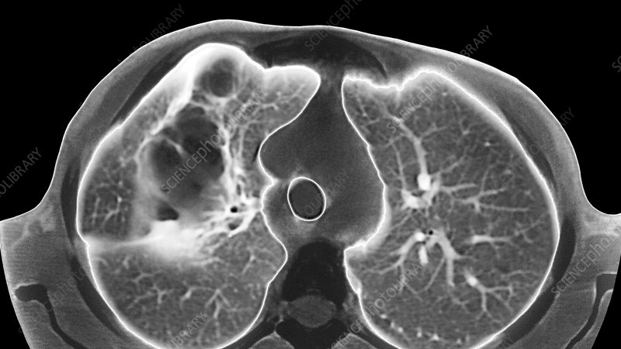
conclusion
Many of the research were using traditional ML algorithms like support vector machine(SVM) but on the other side nature inspired algorithm were also contributing.
It seems that CT scan images were widely used because a CT scan generates high-quality, detailed images of the body.

Slide 15
FUTURE SCOPE
Every day a large number of people are dying due to lung cancer disease. Millions of people died till date. By each passing day the number of patients is increasing.
In year 2021 (130,180) deaths of both men and women from the lung cancer.
As the medical imaging is getting advanced the researchers are coming up with different approaches and models to detect it through computational intelligence.

Slide 16
drawback
Subsolid nodules cannot be detected till now.
Irregular shape nodules are still detected with low accuracy.
CT scan should be of person more than age 35
Person should have any prior heavy smoking history.
Only nodule with diameter of 3 or more than 3 cm can be detected

Slide 17
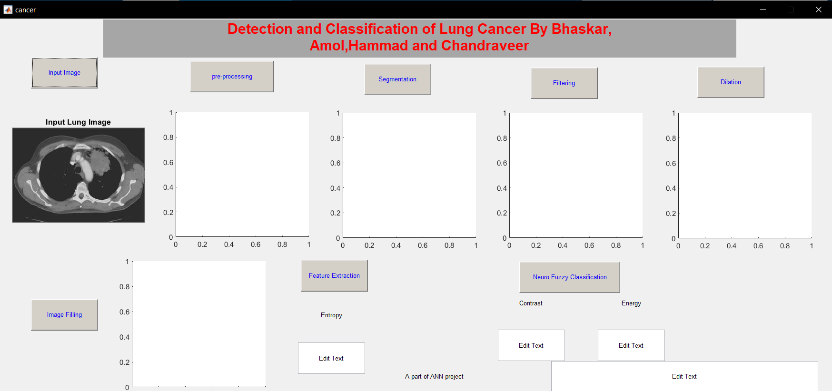
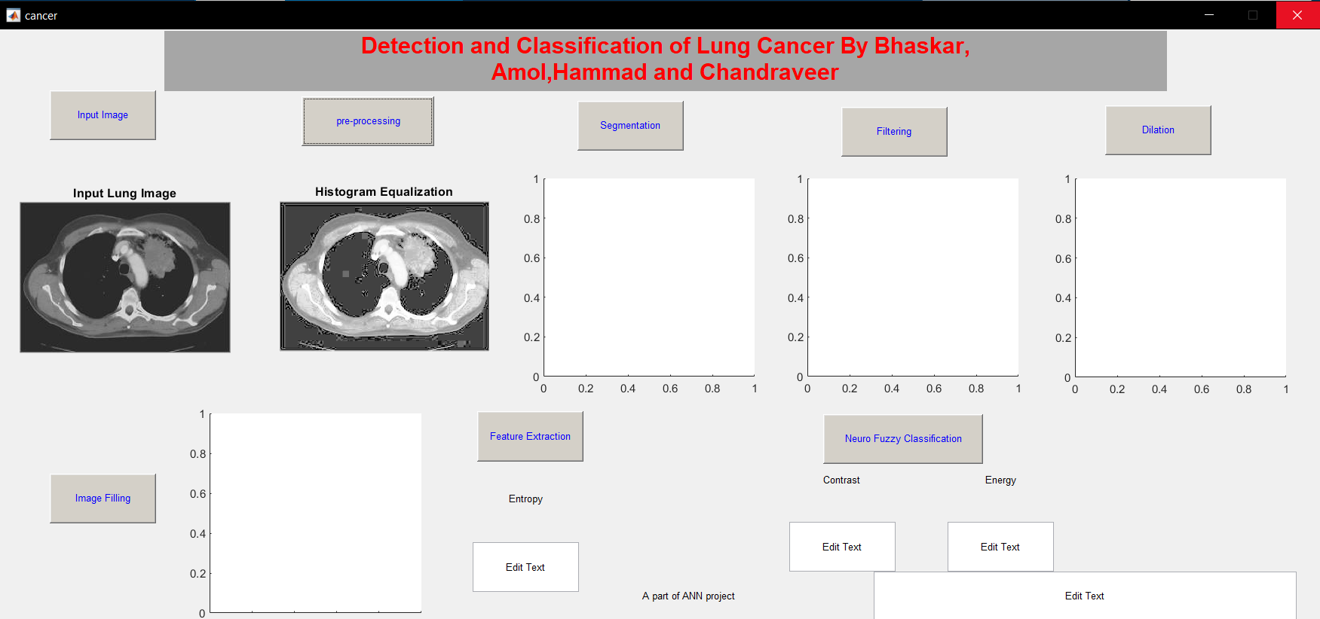
DEMO OF THE PROJECT input image pre-processing

Slide 18
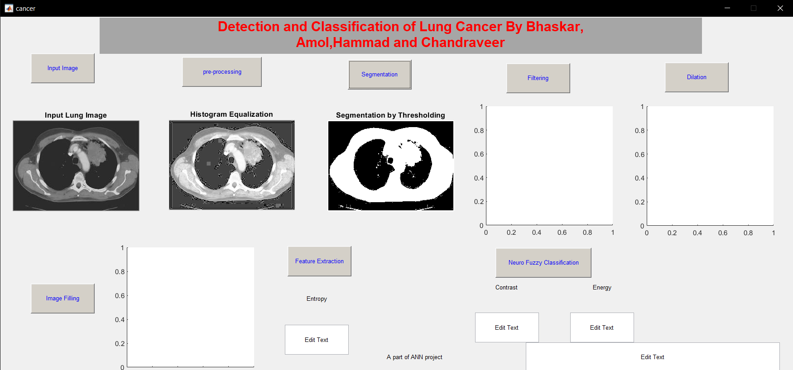
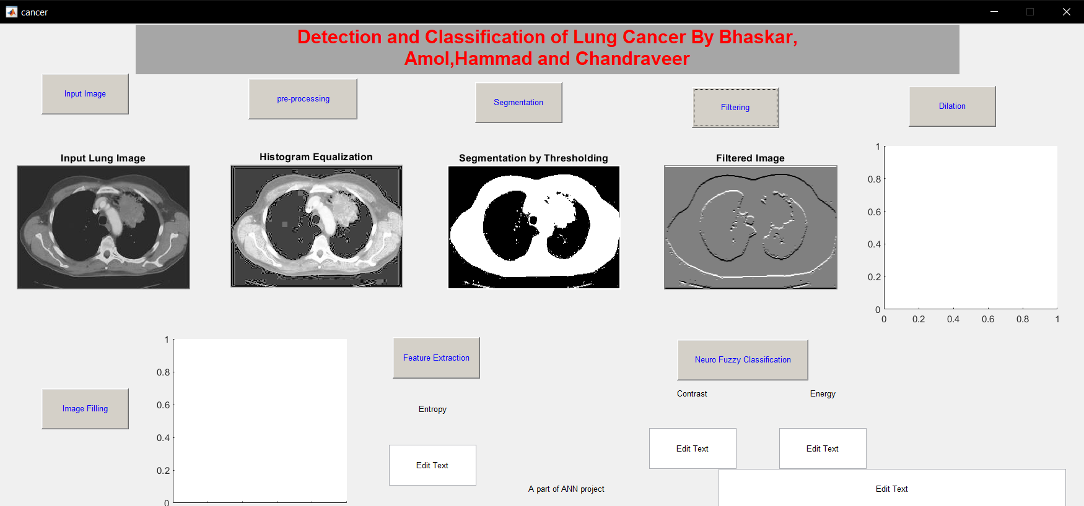
Segmentation filtered image

Slide 19
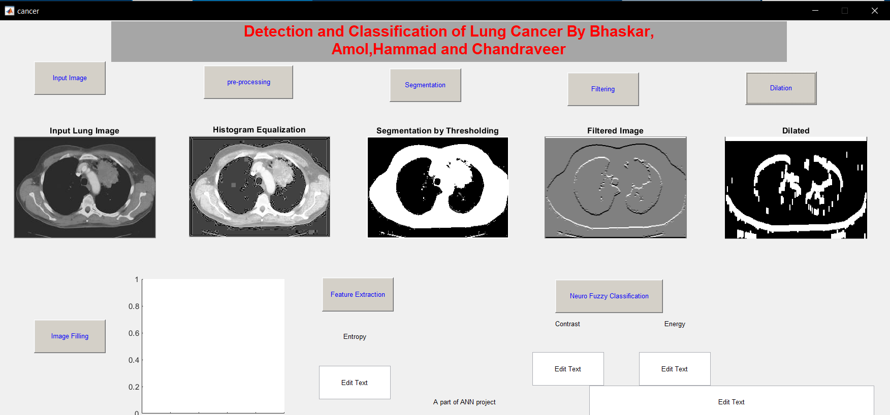
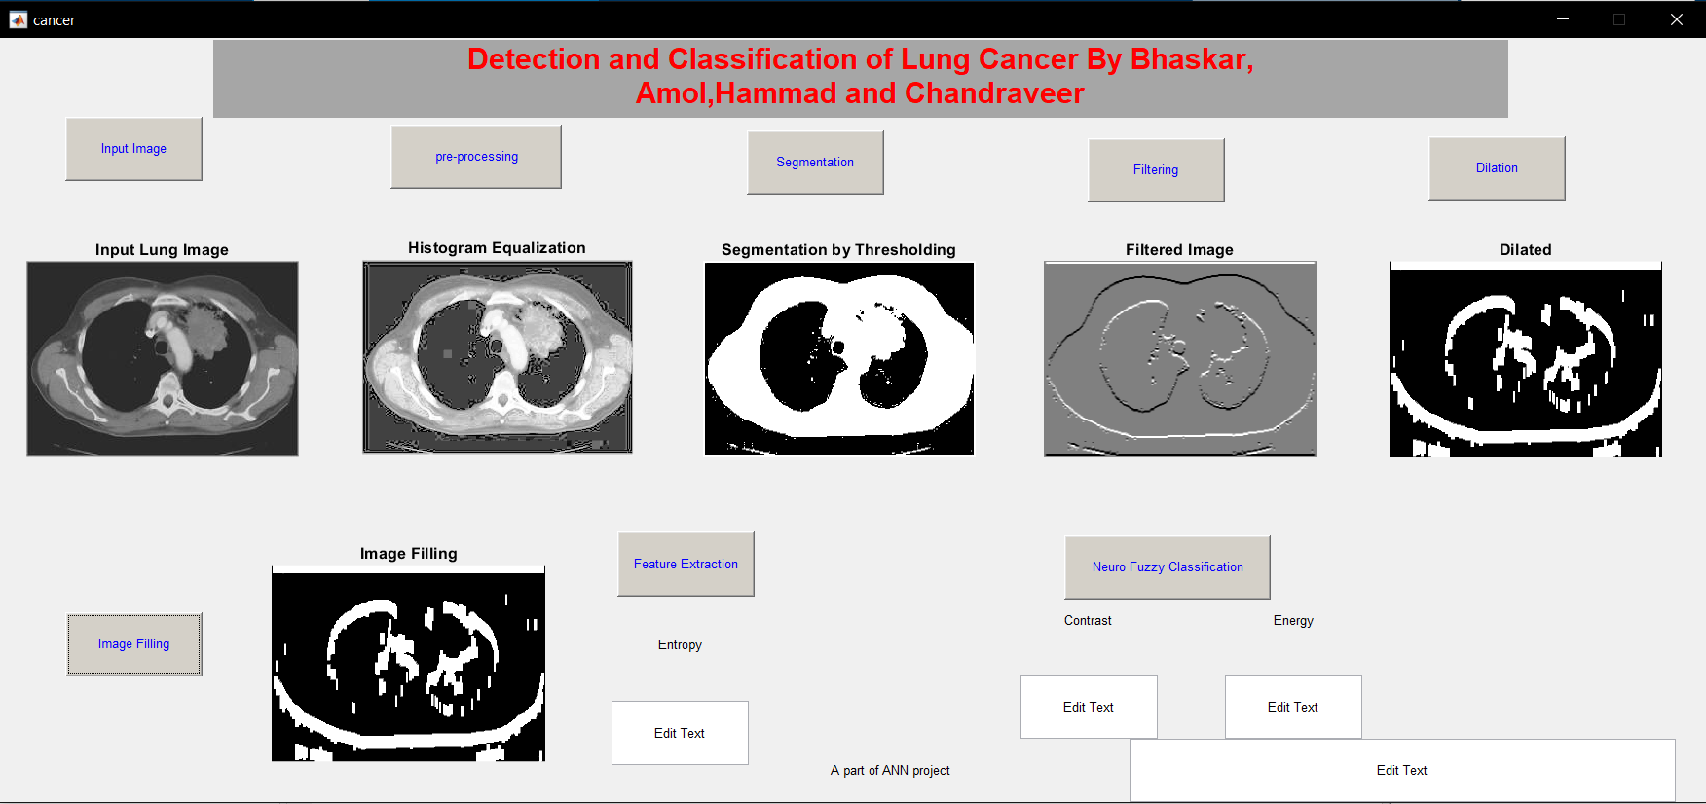
Dilated image filling

Slide 20
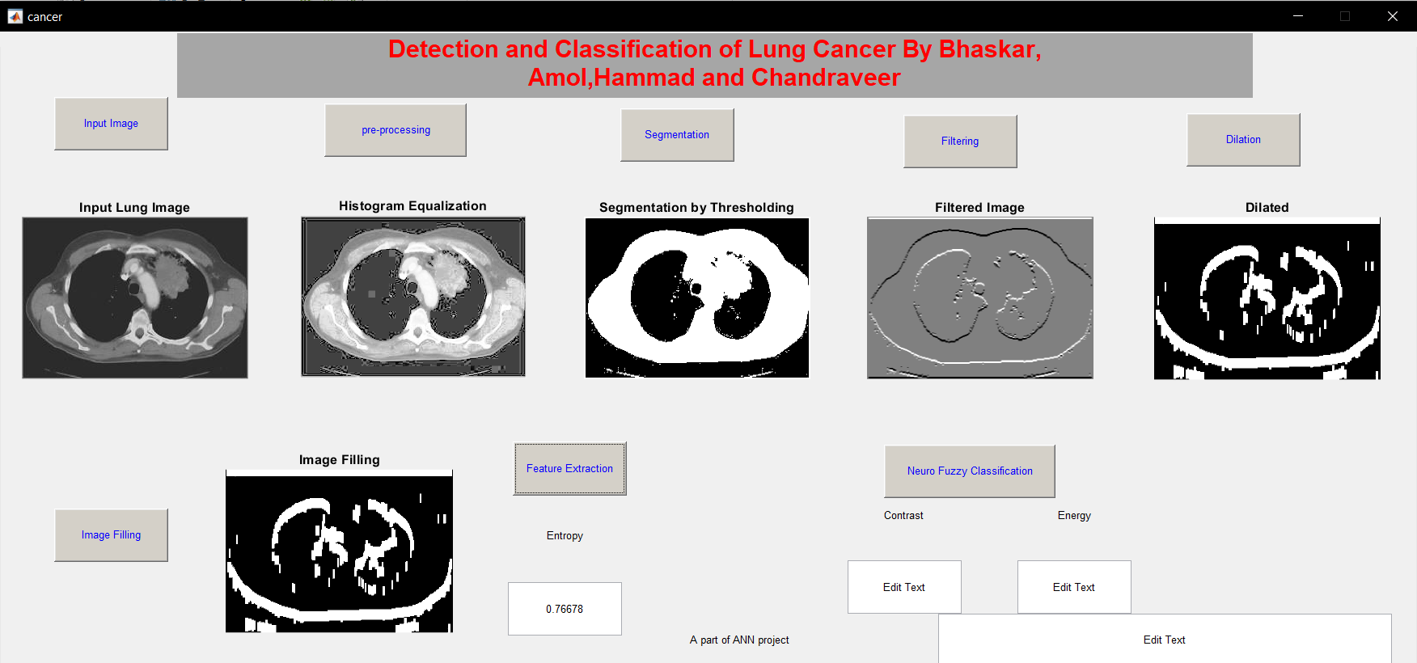
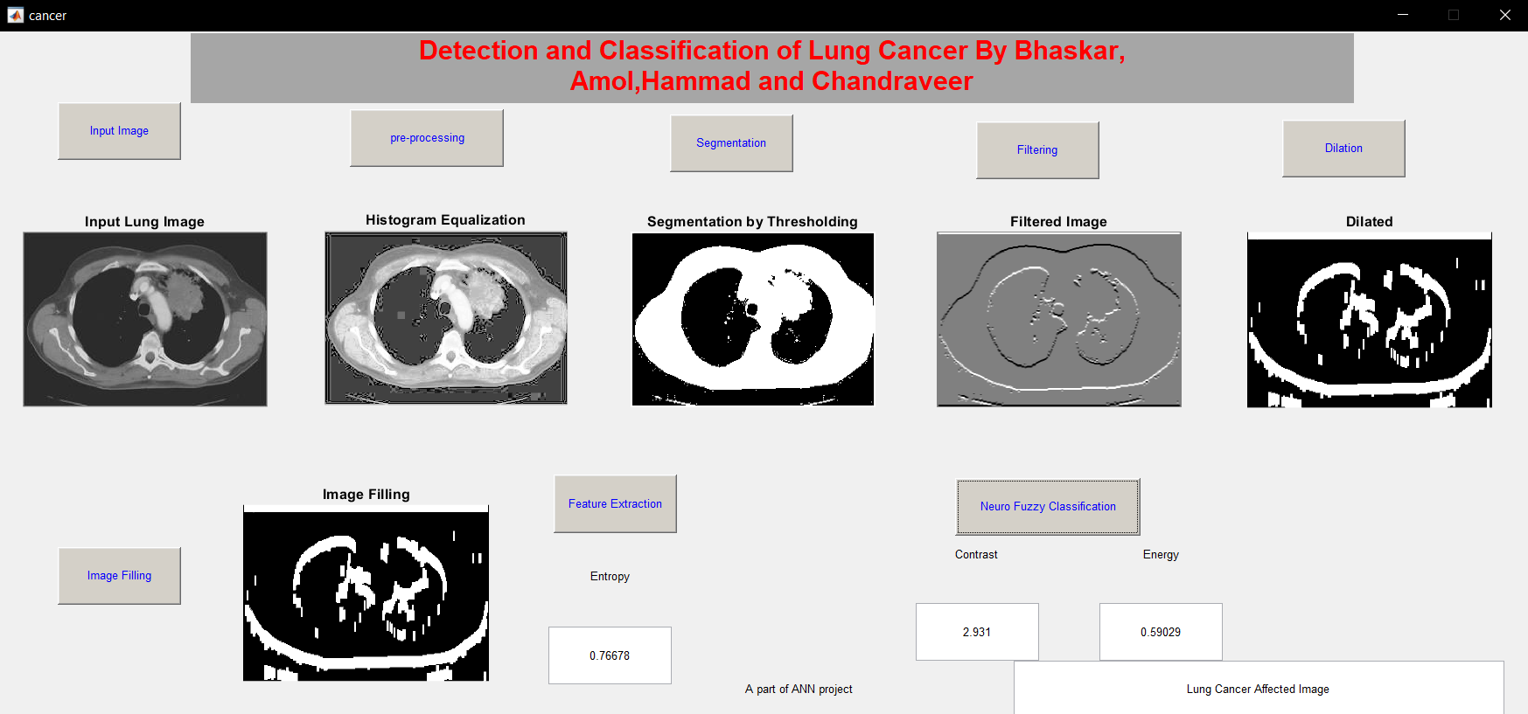
Feature extraction neuro fuzzy classifier

Slide 21
REFRENCES
[1] Nawreen, Nusraat, Umma Hany, and Tahmina Islam. "Lung Cancer Detection and Classification using CT Scan Image Processing." In 2021 International Conference on Automation, Control and Mechatronics for Industry 4.0 (ACMI), pp. 1-6. IEEE, 2021.
[2] Agarwal, Aman, Kritik Patni, and D. Rajeswari. "Lung cancer detection and classification based on alexnet CNN." In 2021 6th International Conference on Communication and Electronics Systems (ICCES), pp. 1390-1397. IEEE, 2021.
[3] Firdaus, Qurina, Riyanto Sigit, Tri Harsono, and Anwar Anwar. "Lung Cancer Detection Based On CT-Scan Images With Detection Features Using Gray Level Co-Occurrence Matrix (GLCM) and Support Vector Machine (SVM) Methods." In 2020 International Electronics Symposium (IES), pp. 643-648. IEEE, 2020.
[4] Abdullah, Mohd Firdaus, Siti Noraini Sulaiman, Muhammad Khusairi Osman, Noor Khairiah A. Karim, Ibrahim Lutfi Shuaib, and Muhamad Danial Irfan Alhamdu. "Classification of Lung Cancer Stages from CT Scan Images Using Image Processing and k-Nearest Neighbours." In 2020 11th IEEE Control and System Graduate Research Colloquium (ICSGRC), pp. 68-72. IEEE, 2020.
[5] de Pinho Pinheiro, Cesar Affonso, Nadia Nedjah, and Luiza de Macedo Mourelle. "Detection and classification of pulmonary nodules using deep learning and swarm intelligence." Multimedia Tools and Applications 79, no. 21 (2020): 15437-15465..
[6] Basha, B. Mohamed Faize, and M. Mohamed Surputheen. "The Lung Cancer Predictive Accuracy for Non-Smokers Using Classification and HFPS Algorithm." Turkish Journal of Computer and Mathematics Education (TURCOMAT) 12, no. 6 (2021): 3160-3171.

Slide 22
[7] Prabhakar, Sunil Kumar, Harikumar Rajaguru, and Dong-Ok Won. "A Holistic Performance Comparison for Lung Cancer Classification Using Swarm Intelligence Techniques." Journal of Healthcare Engineering 2021 (2021).
[8] Vasani, Khevna, And Ayushi Shah. "Lung Cancer Detection Using Ct Scan Images." IRJET(2021).
[9] Isaac, Anisha, H. Khanna Nehemiah, Snofy D. Dunston, VR Elgin Christo, and A. Kannan. "Feature selection using competitive coevolution of bio-inspired algorithms for the diagnosis of pulmonary emphysema." Biomedical Signal Processing and Control 72 (2022): 103340.
[10] Johora, Fatema Tuj, Mehdi Hassan Jony, Md Shakhawat Hossain, and Humayun Kabir Rana. "Lung Cancer Detection Using Marker Controlled Watershed with SVM." GUB Journal of Science and Engineering 5, no. 1 (2018): 24-30.
[11] Makaju, Suren, P. W. C. Prasad, Abeer Alsadoon, A. K. Singh, and A. Elchouemi. "Lung cancer detection using CT scan images." Procedia Computer Science 125 (2018): 107-114.
[12] Rani, R. Ranjani, and D. Ramyachitra. "Microarray cancer gene feature selection using spider monkey optimization algorithm and cancer classification using SVM." Procedia computer science 143 (2018): 108-116.

Slide 23

THANK YOU

